Slide 1
CrowdDoc
Project focus
Crowdsourcing Code Comments with ChatGPT
Linux v6.12 source demo
Writer + Reviewer
Human correction and voting
Source remains read-only
Milestone 1 Presentation
Ahmed Alzahrani and Mohammed Zakry
Faculty Advisor / Client: Professor Marius Silaghi
FLORIDA
TECH

Slide 2
Milestone 1 Progress Matrix
Simple progress view for the current milestone
Task | Done | Ahmed | Mohammed | To do
Requirements document | 100% | 50% | 50% | none
Design document | 100% | 50% | 50% | none
Test plan | 100% | 50% | 50% | none
Local prototype | 100% | 50% | 50% | none
Writer + Reviewer examples | prepared | 50% | 50% | live AI in M2
Human correction + voting | prototype | 50% | 50% | none
FLORIDA
TECH

Slide 3
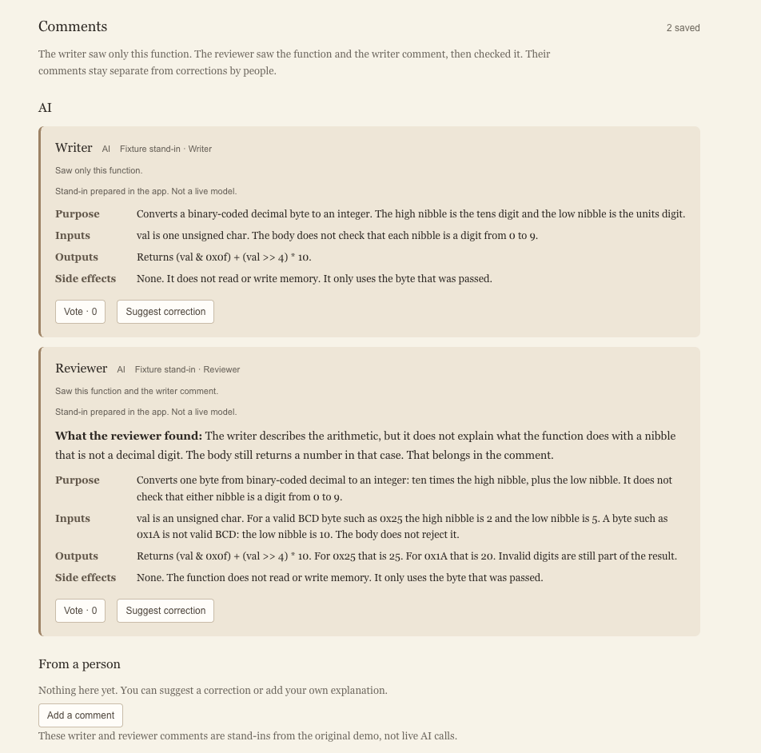
Prototype Demo
Matched example: _bcd2bin From lib/bcd.c
Read-only source: _bcd2bin
unsigned _bcd2bin(unsigned char val)
{
return (val & 0x0f) + (val >> 4) * 10;
}
Important: these displayed AI comments are prepared stand-ins, not live AI calls.
FLORIDA
TECH

Slide 4
Technical Tools
Tools used in the current CrowdDoc prototype
Web interface
C source parsing
Saved data
SQLite
Used to save function records, explanations, corrections, and votes separately from source code.
Next.js, React, and TypeScript
Used for the pages, function view, correction form, and voting controls.
Tree-sitter C
Used to find selected C functions and connect comments to the correct function.
AI agents
Source reference
OpenAI API
Planned for live Writer and Reviewer calls on selected functions.
Linux v6.12 selected files
Elixir / Bootlin link
Used to show the original source while keeping it read-only.
FLORIDA
TECH

Slide 5
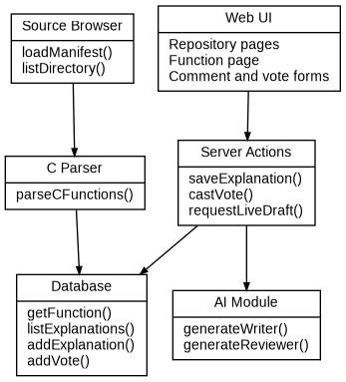
Design Document: System Architecture and UML
User-facing
Server side
Data
Browser
Repository pages
Function page
Correction/vote forms
Next.js server
Tree-sitter C parser
SQLite database
OpenAI API calls
Function record
Explanation record
Vote record
Source hash
FLORIDA
TECH

Slide 6
Requirements and Test Plan
Functional requirements
Interface requirements
Planned tests
Browse selected Linux v6.12 files and functions
Open selected functions
Writer explanation
Reviewer checks Writer
Human correction
Vote on explanations
Breadcrumbs
Read-only source view
Clear AI / human labels
Correction form
Vote button
Elixir source link
Valid and invalid paths
Missing API key
Empty or long correction
Wrong parent comment
Source remains unchanged
API key not exposed
These are planned test cases from the Test Plan, not final test results.
FLORIDA
TECH

Slide 7
Milestone 2 Plan
Task | Ahmed | Mohammed
Select a C function from a small source set | 50% | 50%
Define how code versions and comments are saved | 50% | 50%
Test live Writer and Reviewer calls on selected functions | 50% | 50%
Test invalid input and API/database errors | 50% | 50%
Main focus
Later work
Small source set, clear data model, live AI tests, and error handling.
User identity, one vote per user, broad repository support, and polished public app.
FLORIDA
TECH

Slide 8
Questions?
CrowdDoc • Milestone 1
FLORIDA TECH

